Slide 1

Social Science Research Design and Statistics, 2/e
Alfred P. Rovai, Jason D. Baker, and Michael K. Ponton
Splitting Files
PowerPoint Prepared by
Alfred P. Rovai
IBM® SPSS® Screen Prints Courtesy of International Business Machines Corporation,
© International Business Machines Corporation.

Slide 2
Splitting Files
The split file procedure will organize SPSS output by groups based on selected grouping variable(s).
One can specify up to eight grouping variables.
The split file procedure works similarly to the select cases procedure. The difference is that one uses the split file procedure to repeat the same analyses, separately, on multiple groups at the same time. For example, if one intends to compute descriptive statistics of females and males separately, one would use the split file procedure. The select cases procedure would only display descriptive statistics for the selected cases, e.g., male only.

Slide 3
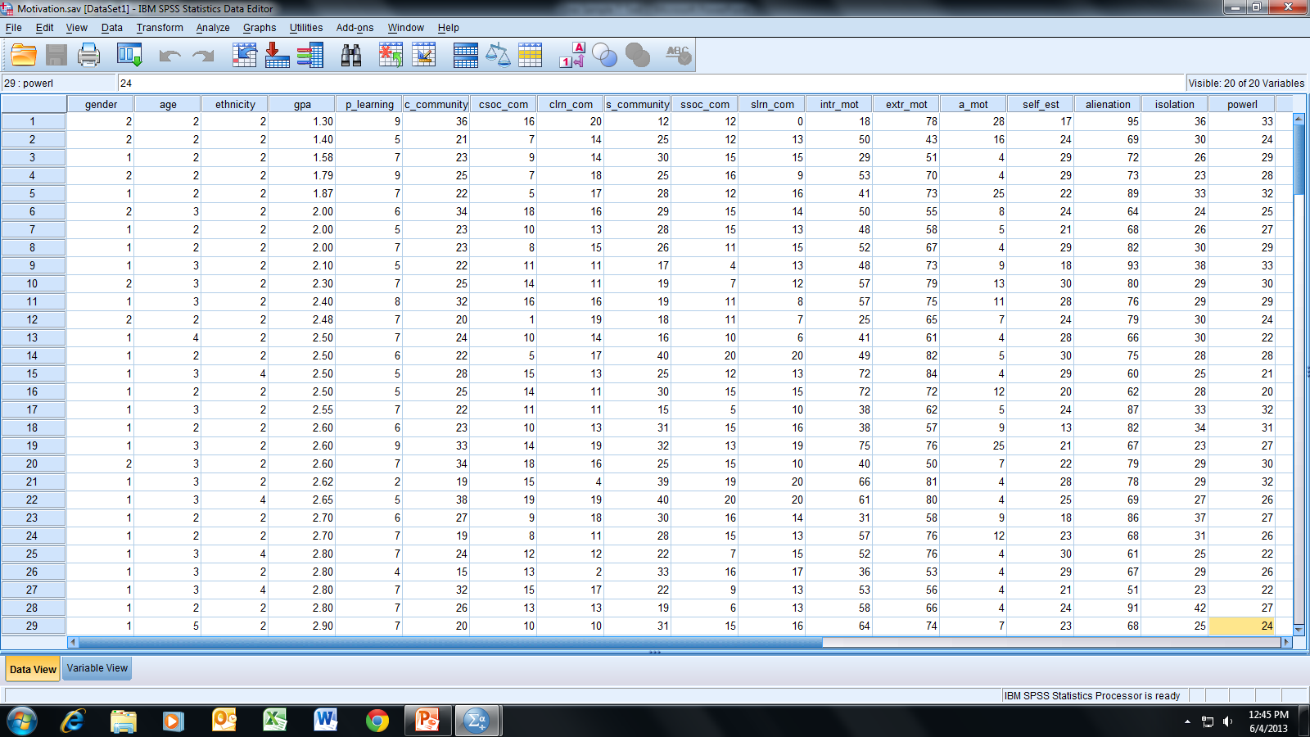
Open the dataset Motivation.sav.
File available at http://www.watertreepress.com/stats
TASK
Split the active file using gender as the first grouping variable and ethnicity as the second grouping variable.

Slide 4
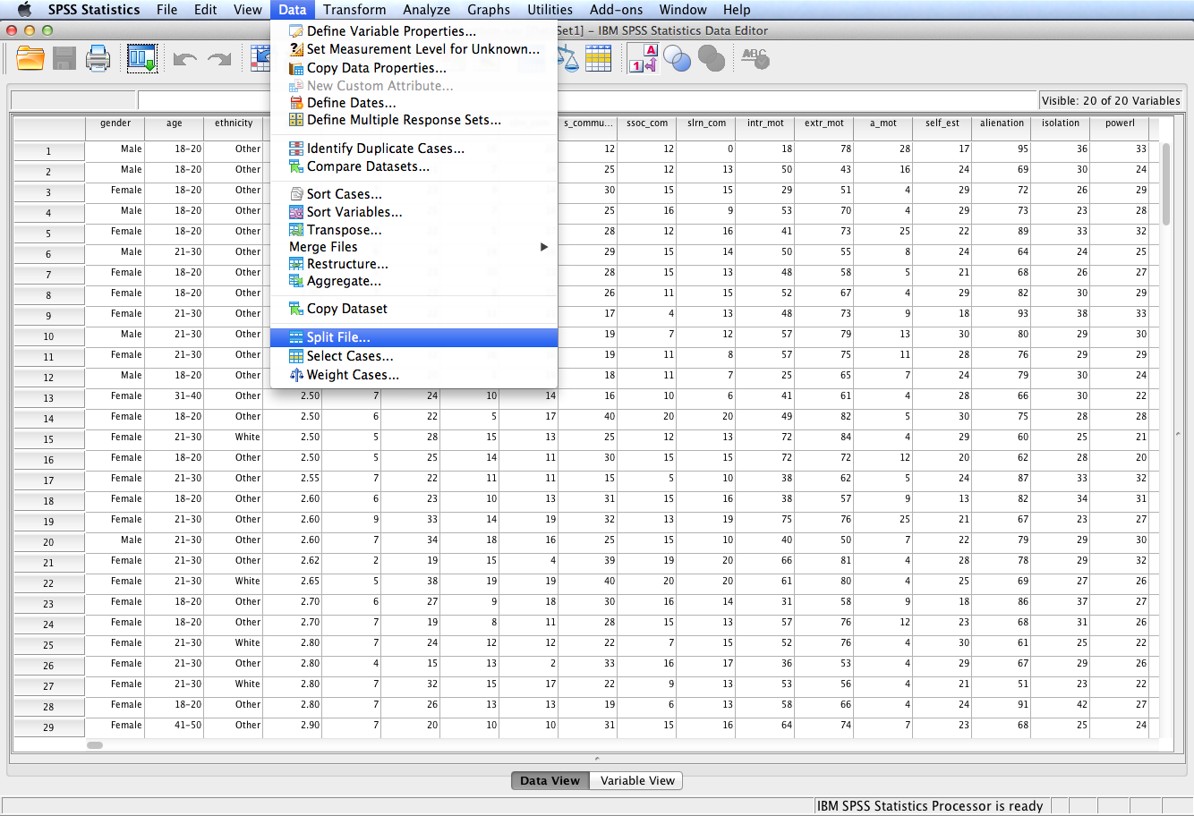
Follow the menu as indicated.

Slide 5
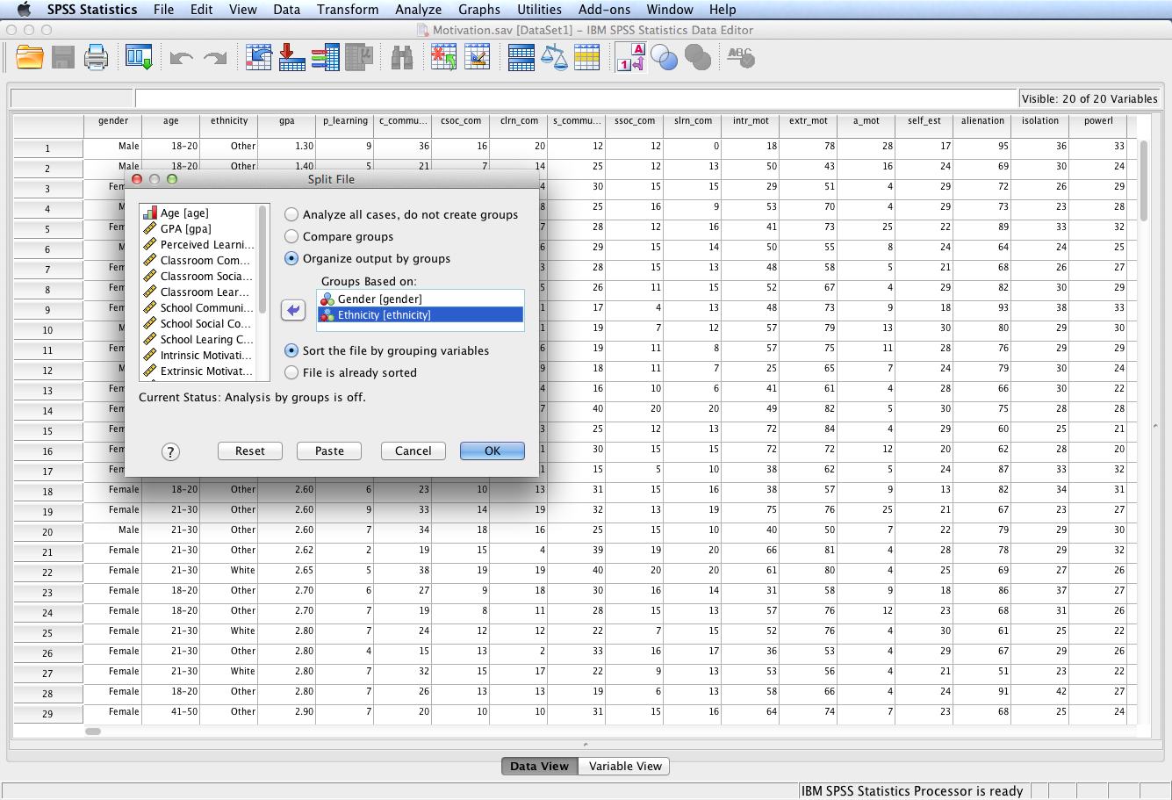
Select Organize output by groups.
All results from each procedure are then displayed separately for each split-file group until Analyze all cases, do not separate groups is selected and executed. If Compare groups is selected, split-file groups are presented together in SPSS output for comparison purposes. For tables, a single table is created and each split-file variable can be moved between table dimensions. For charts, a separate chart is created for each split-file group and the charts are displayed together in the output.
Cases should be sorted by values of the grouping variables and in the same order that variables are listed in the Groups Based On list. If the data file is not already sorted, select Sort the file by grouping variables. Click OK.
Move the variables gender and ethnicity to the Groups Based On: box. Cases will be grouped by ethnicity within each gender category.

Slide 6
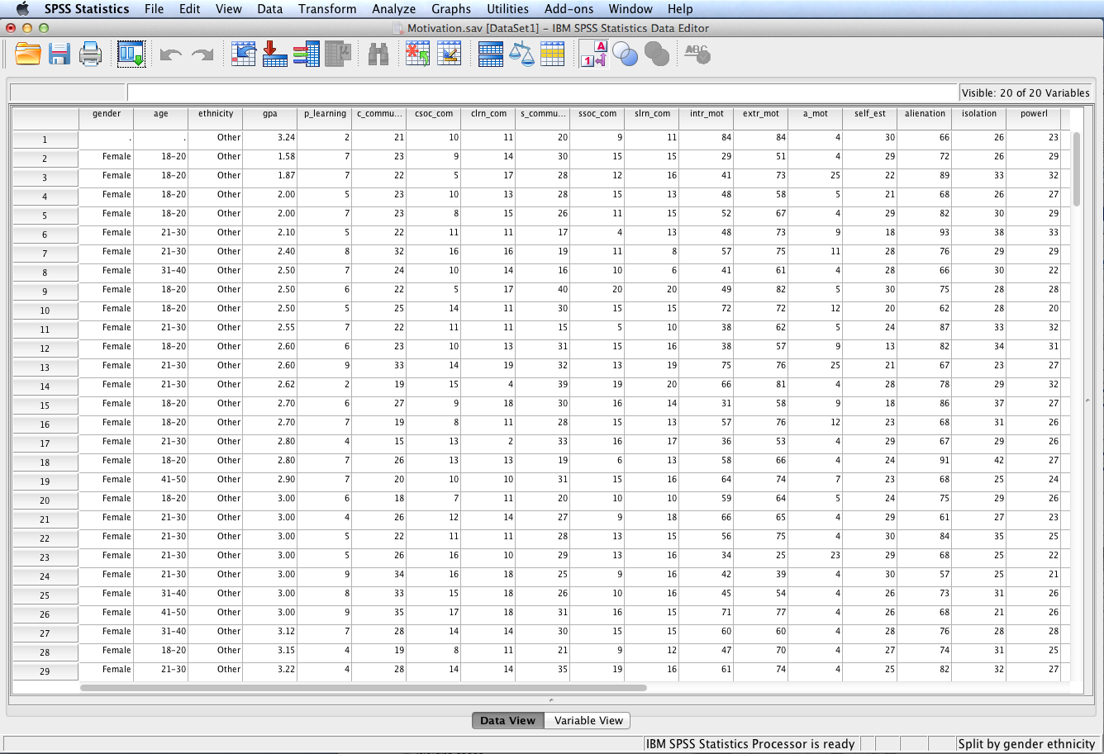
The file is now properly sorted by cases based on gender (primary sort) and ethnicity (secondary sort).
Note that case #1 has a missing value for gender. Consequently, it is treated as a separate category.

Slide 7
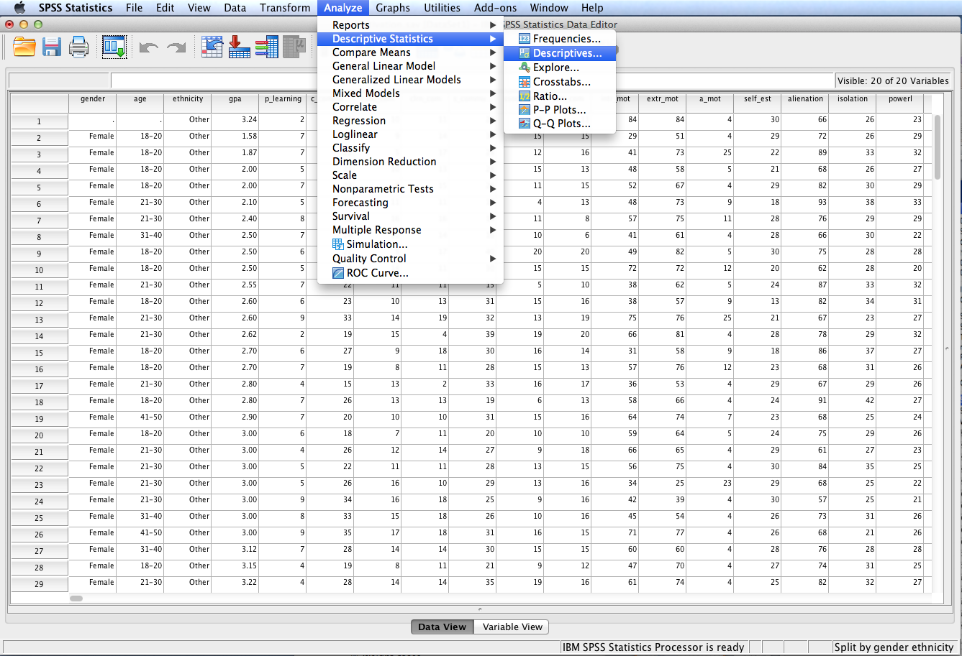
Follow the menu as indicated in order to generate descriptive statistics.

Slide 8
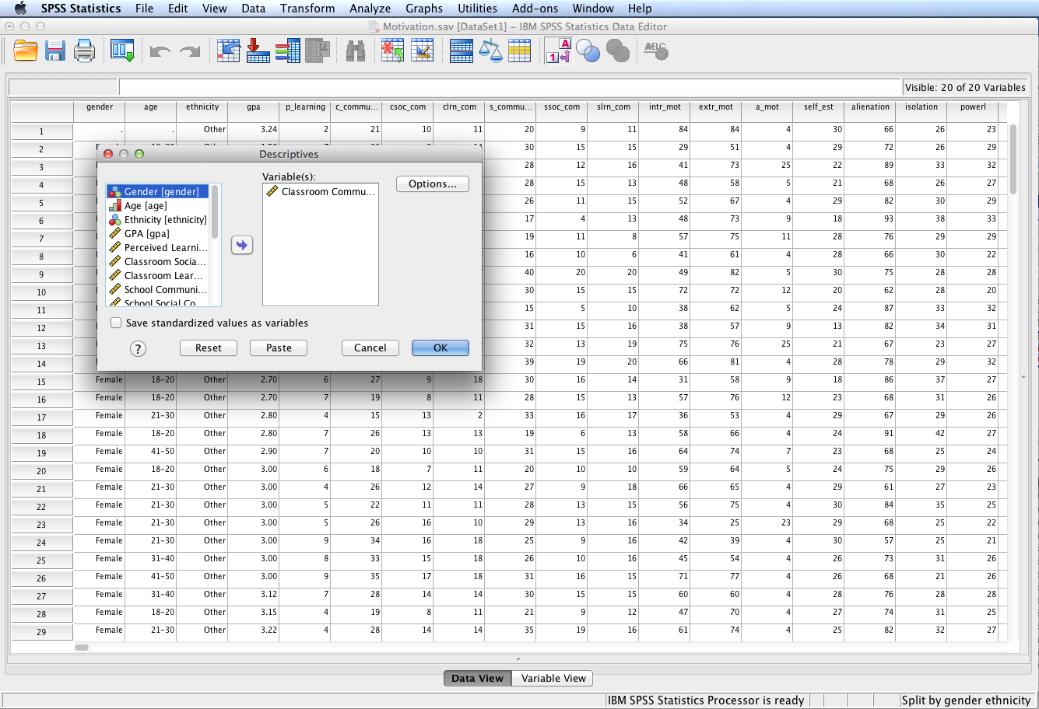
Move classroom community to the Variable(s): box. Click OK.

Slide 9
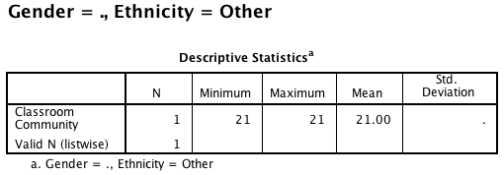
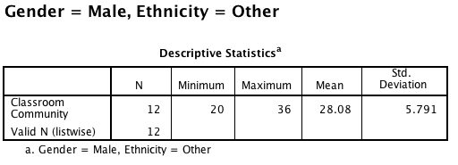
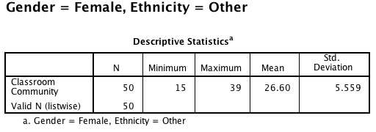
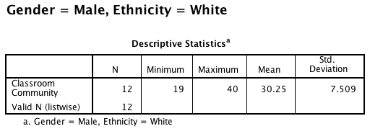
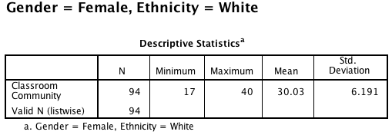
SPSS Output
Notice the SPSS output includes five separate tables instead of one table. (The first table pertains to the single case with missing gender value.)
To restore the dataset to its original un-split status, either close the data file without saving it or execute the split file procedure again by selecting Analyze all cases, do not create groups.

Slide 10
End of Presentation

